Slide 1

VT-ORG Results
Dr. Nicolas foss, ms

Slide 2
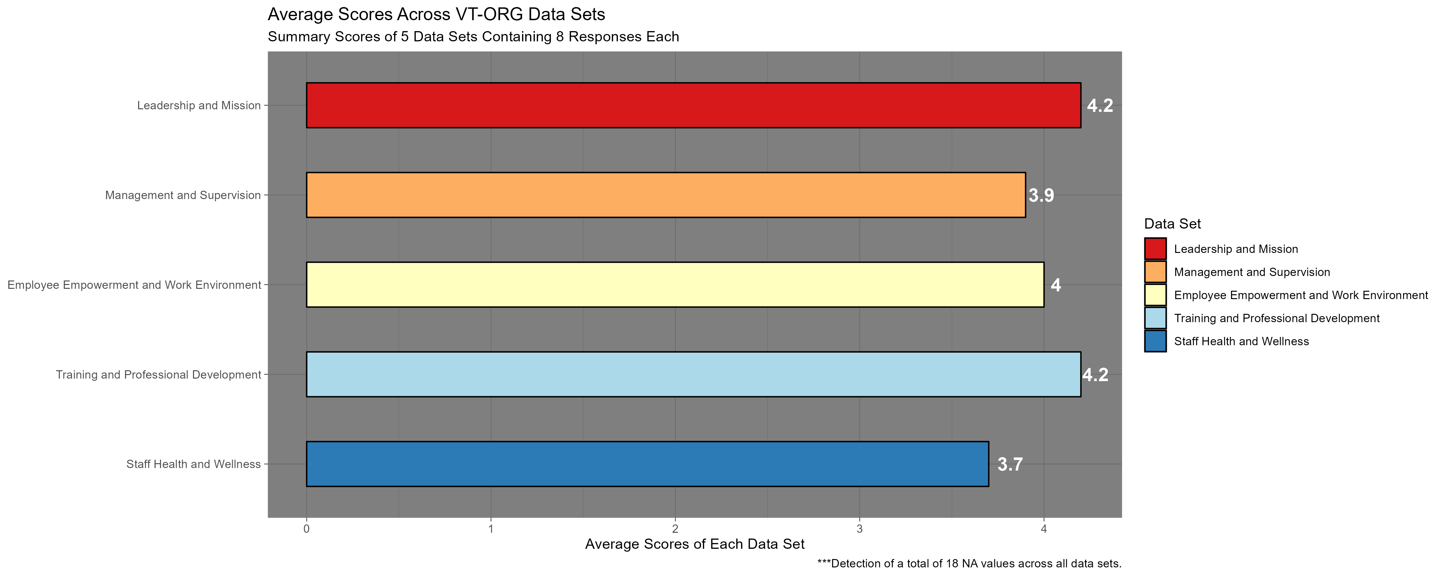
Overall summary: areas needing most improvement are management and supervision and staff health and wellness

Slide 3

Leadership and mission results

Slide 4
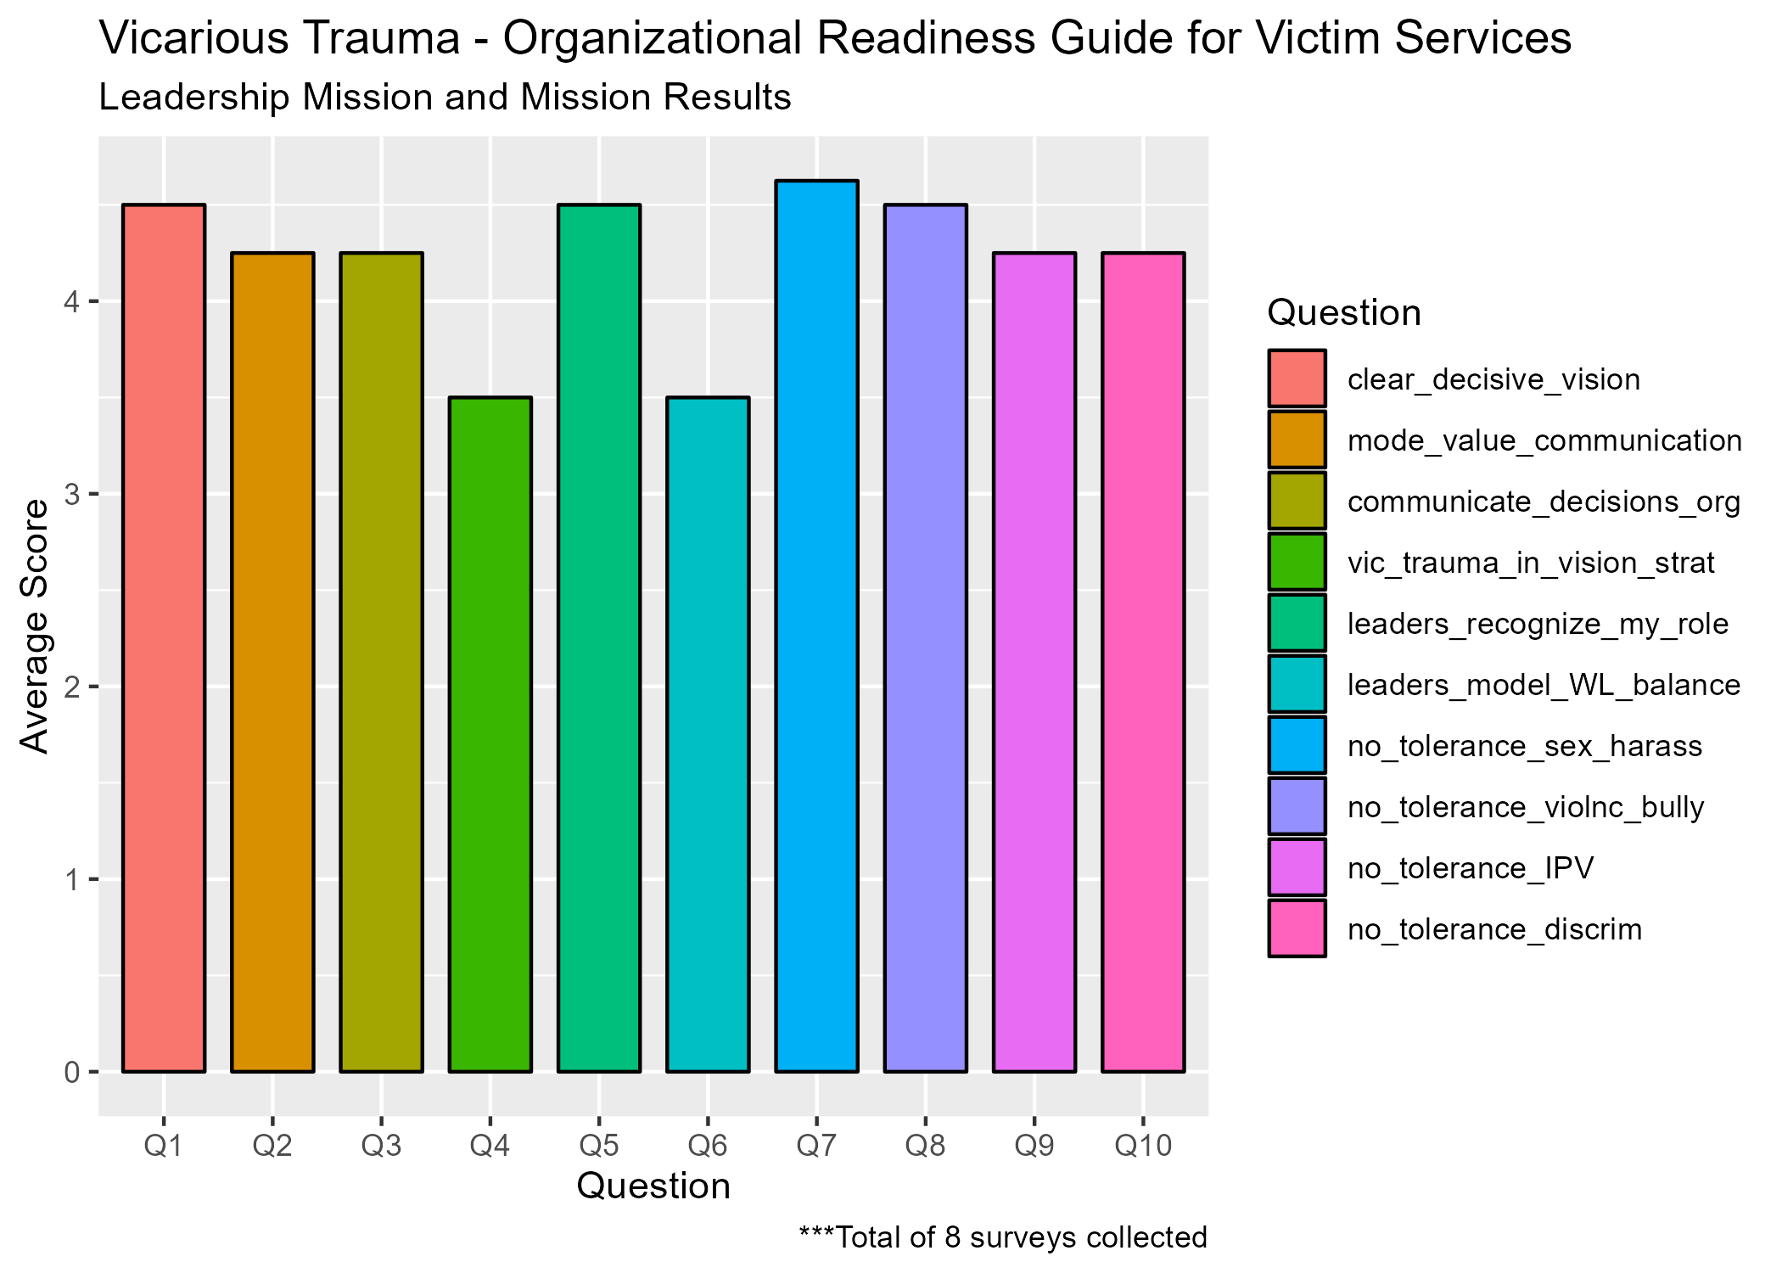
Based on the summary results, questions 4 and 6 seem to require the most attention

Slide 5
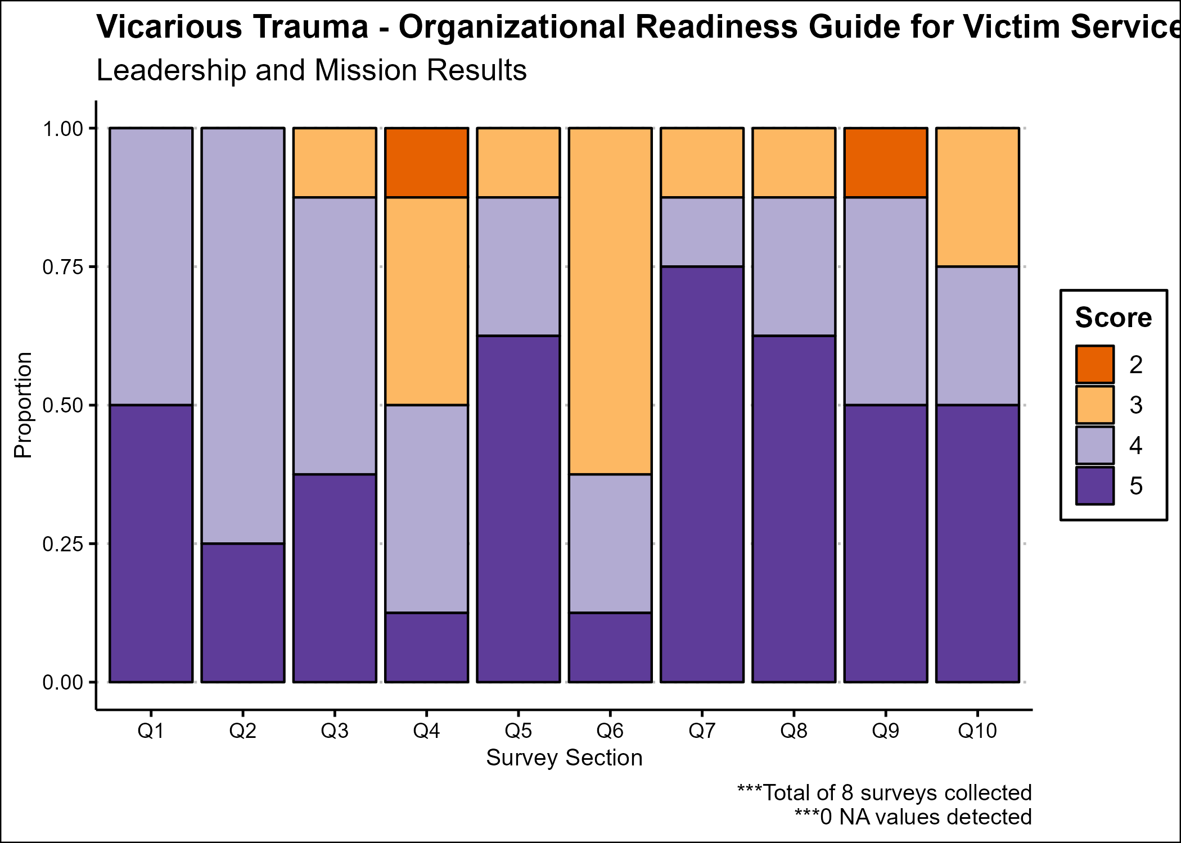
The proportions of the answers also point to questions 4 and 6

Slide 6

Discuss the leadership and Mission results

Slide 7

Management and supervision results

Slide 8
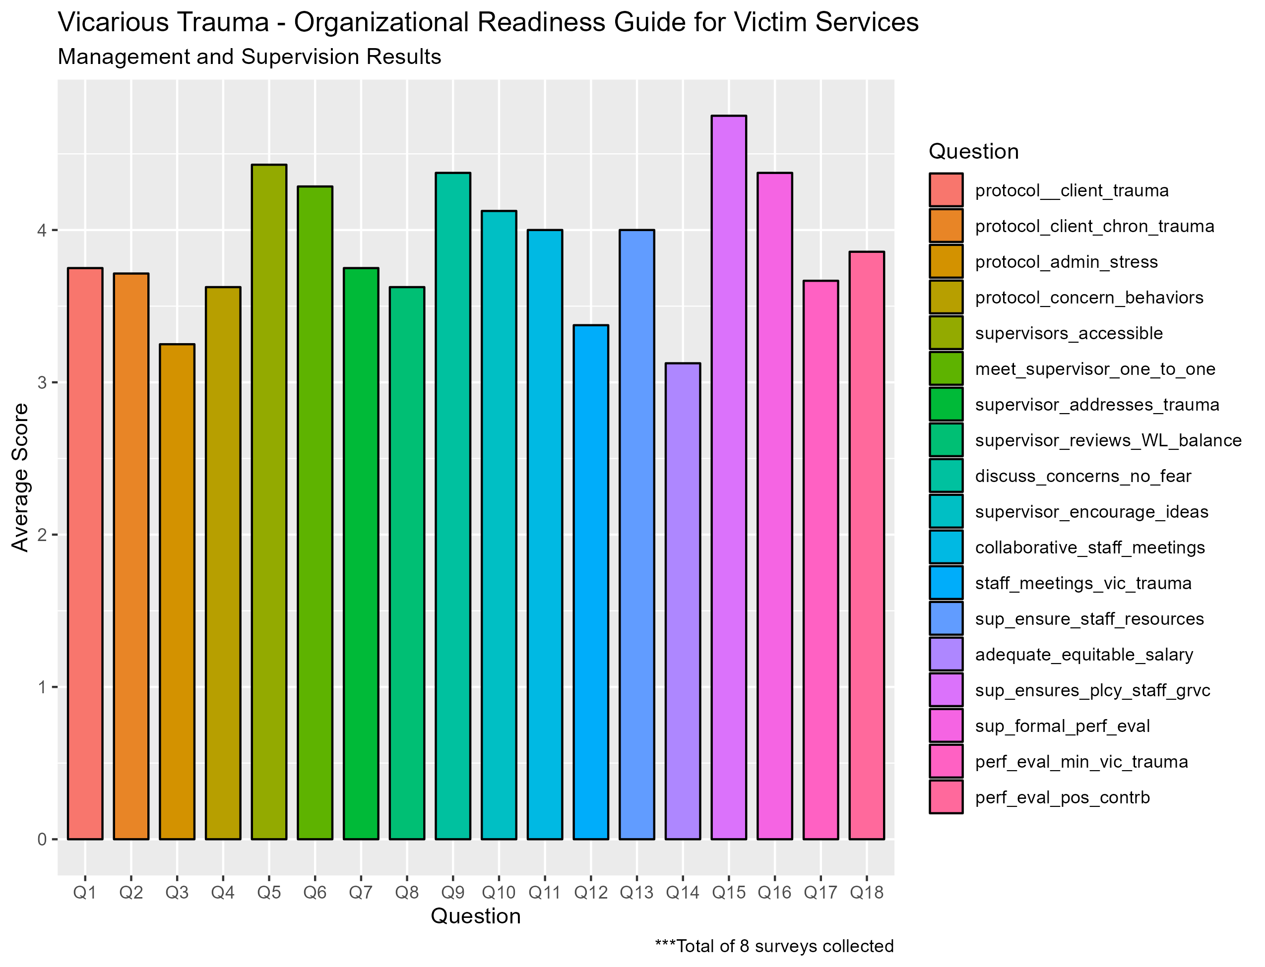
Based on the summary results, questions 1-4, 7-8, 12, 14, and 17-18 require the most attention

Slide 9
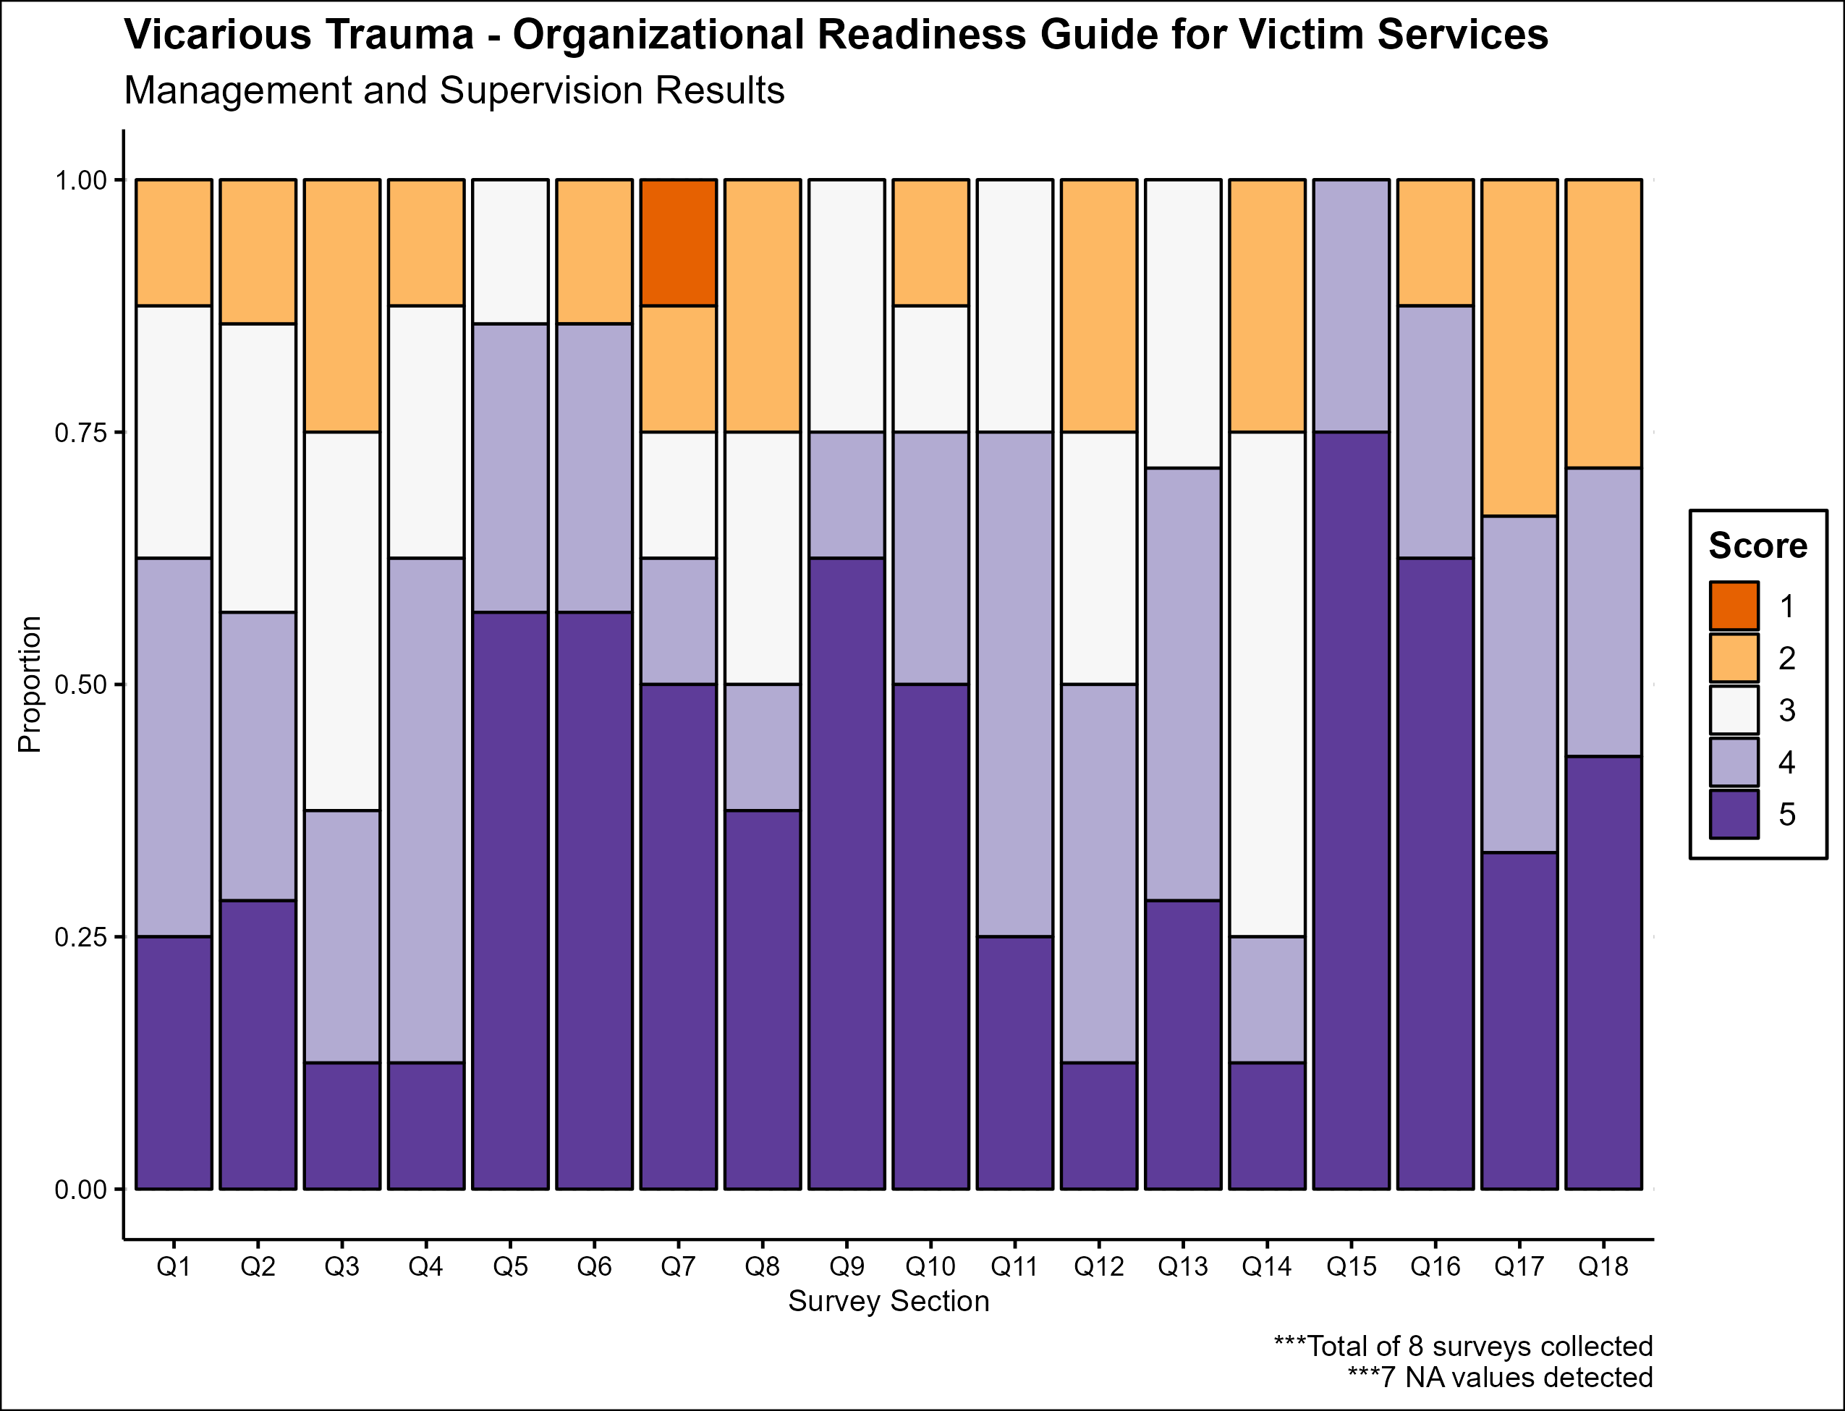
Questions 2-3, 7-8, 12, and 14 deserve the most focus

Slide 10
Discuss the management and supervision results

Slide 11

Employee Empowerment and work environment results

Slide 12
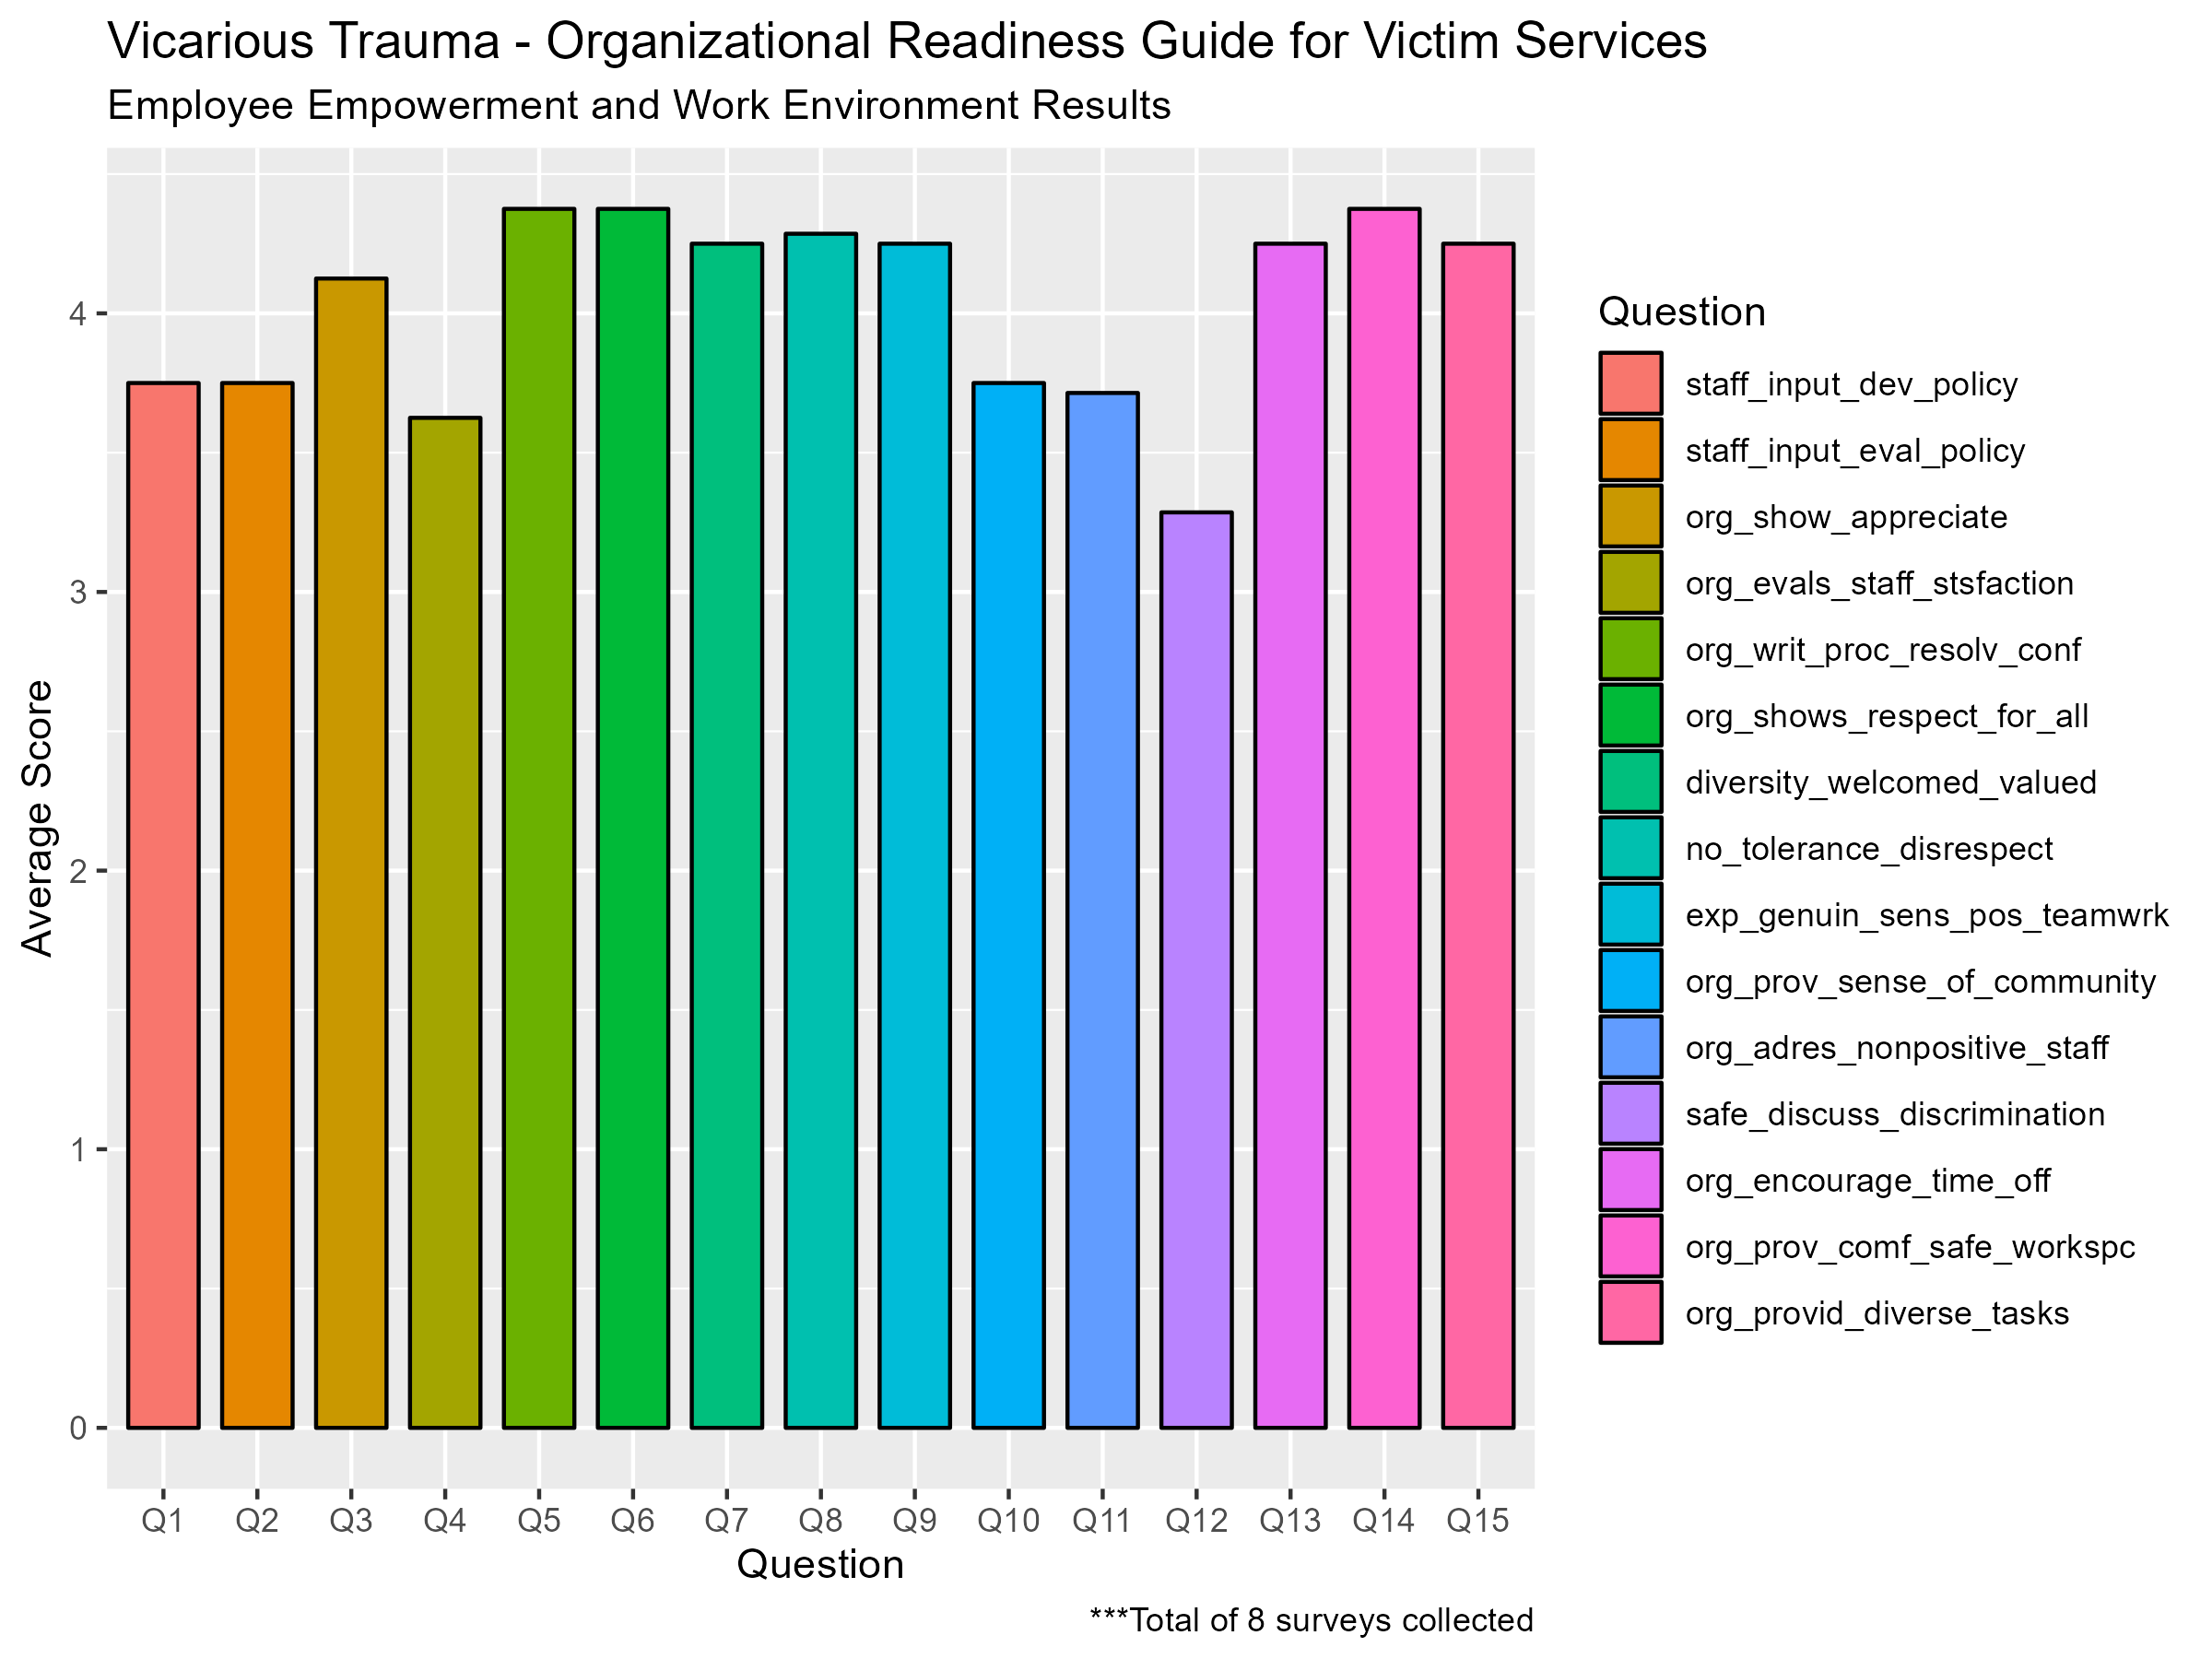
Based on the summary results questions 1-2, 4, 10-12 deserve the most attention

Slide 13
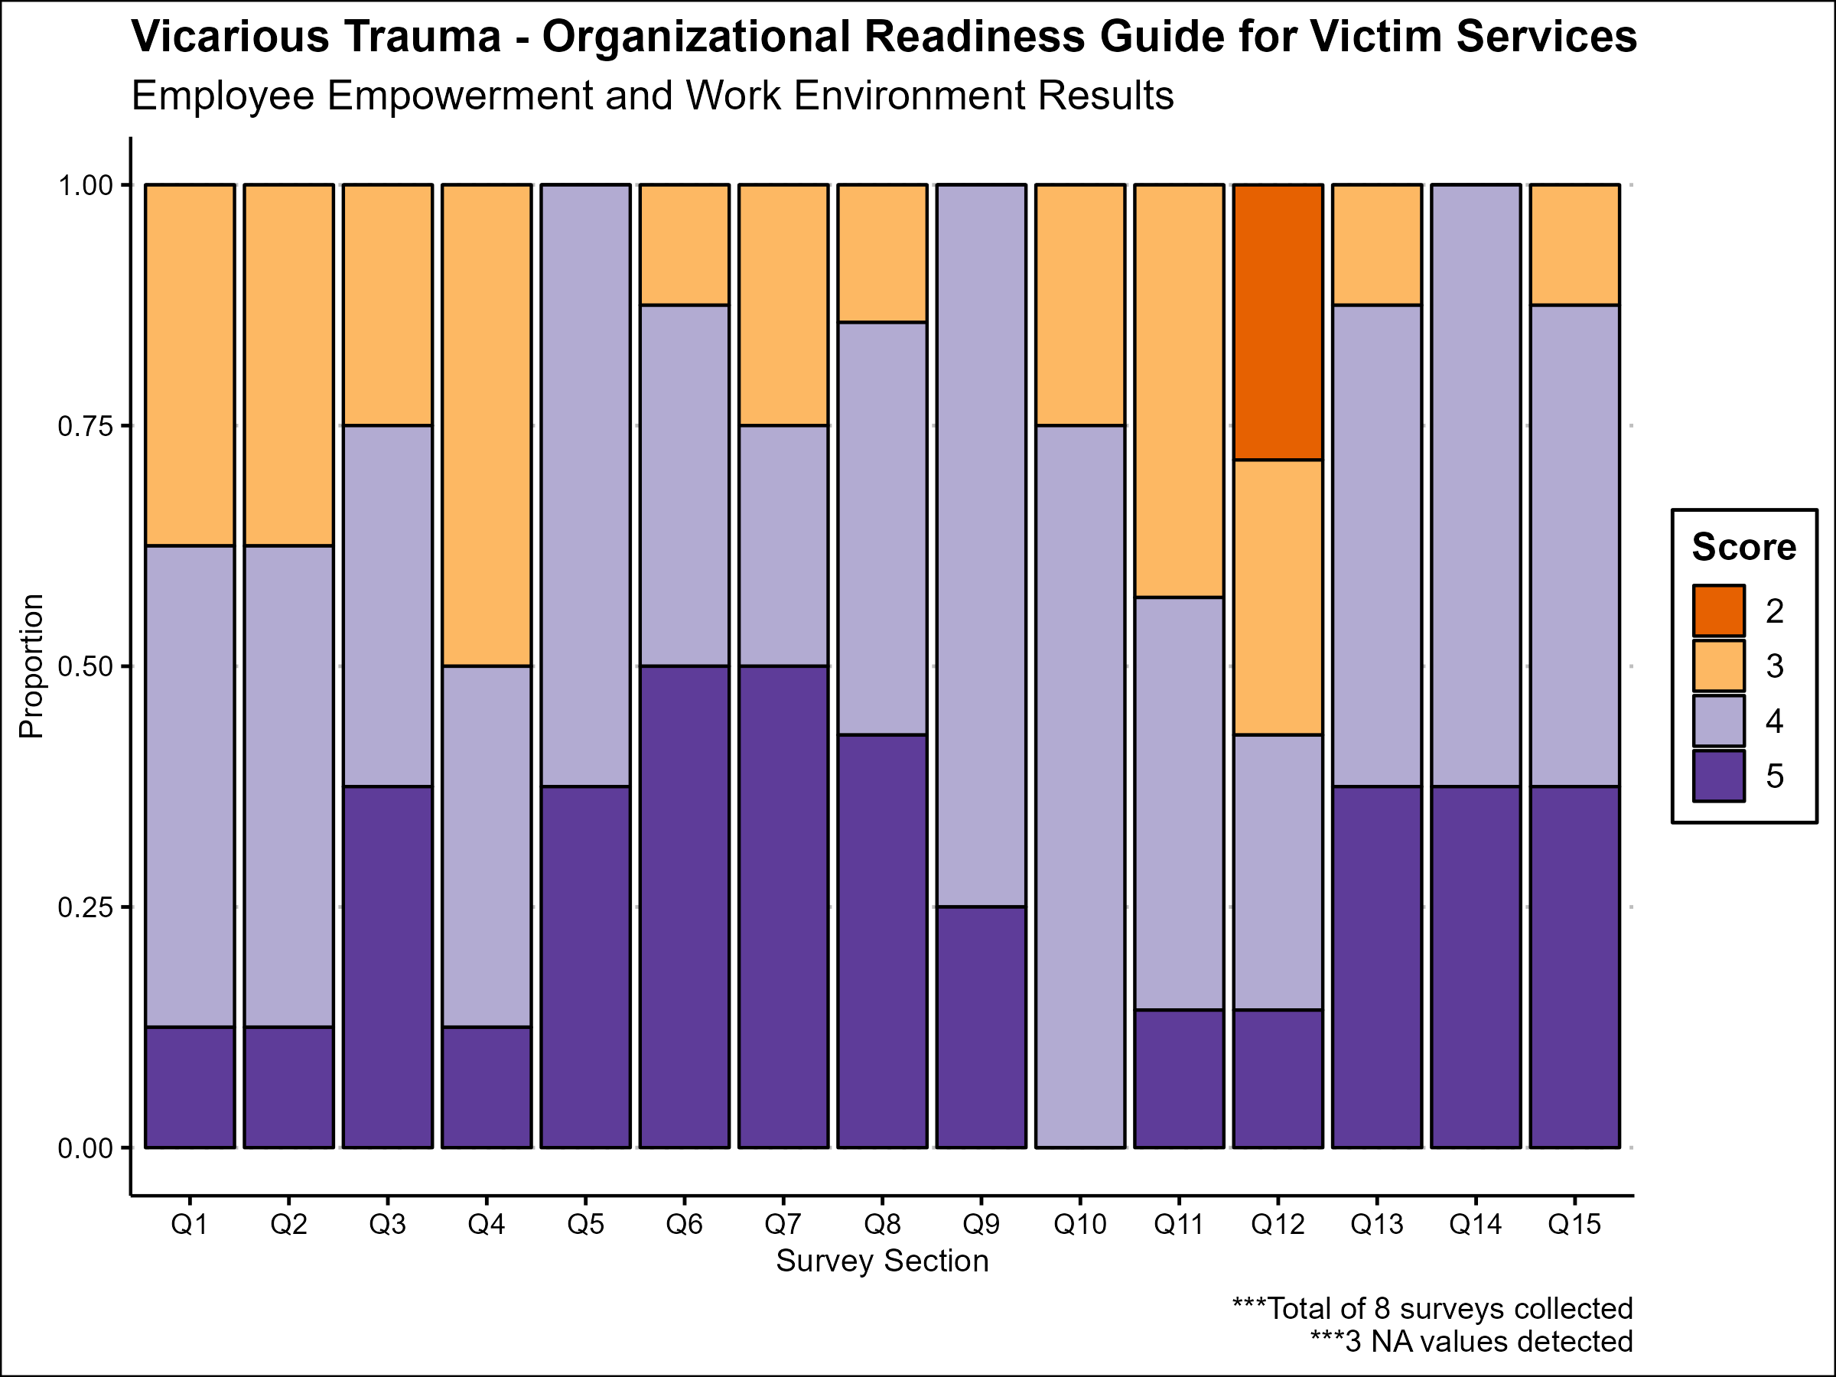
The chart of proportions of answers seems to indicate the same

Slide 14
Discuss the employee empowerment and work environment results

Slide 15

Training and professional development results

Slide 16
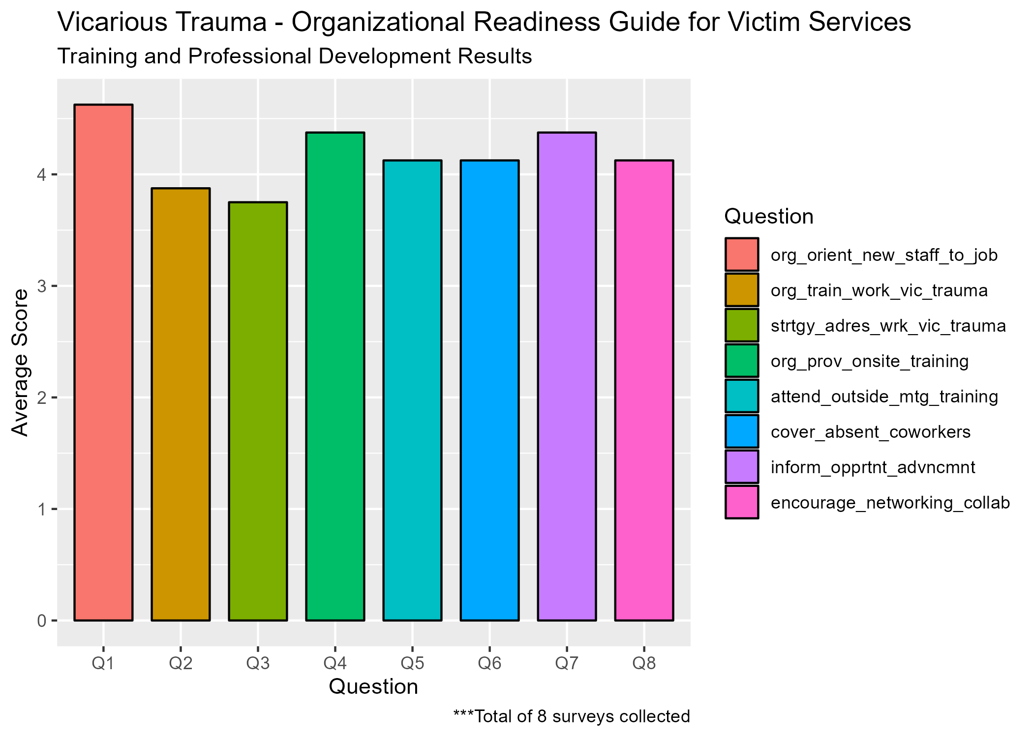
Based on the summary plot, questions 2-3 deserve the most attention

Slide 17
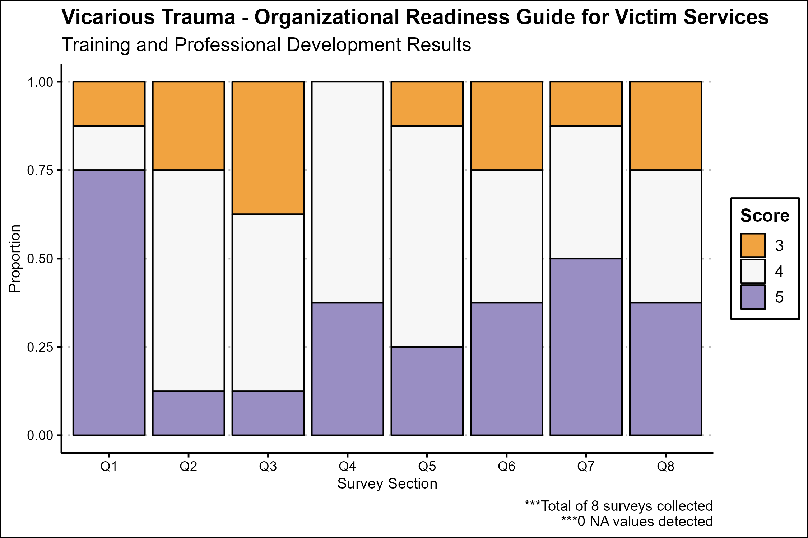
Based on the proportion of answers, questions 6 and 8 should be reviewed as well

Slide 18
Discuss the training and professional development results

Slide 19

Staff health and wellness

Slide 20
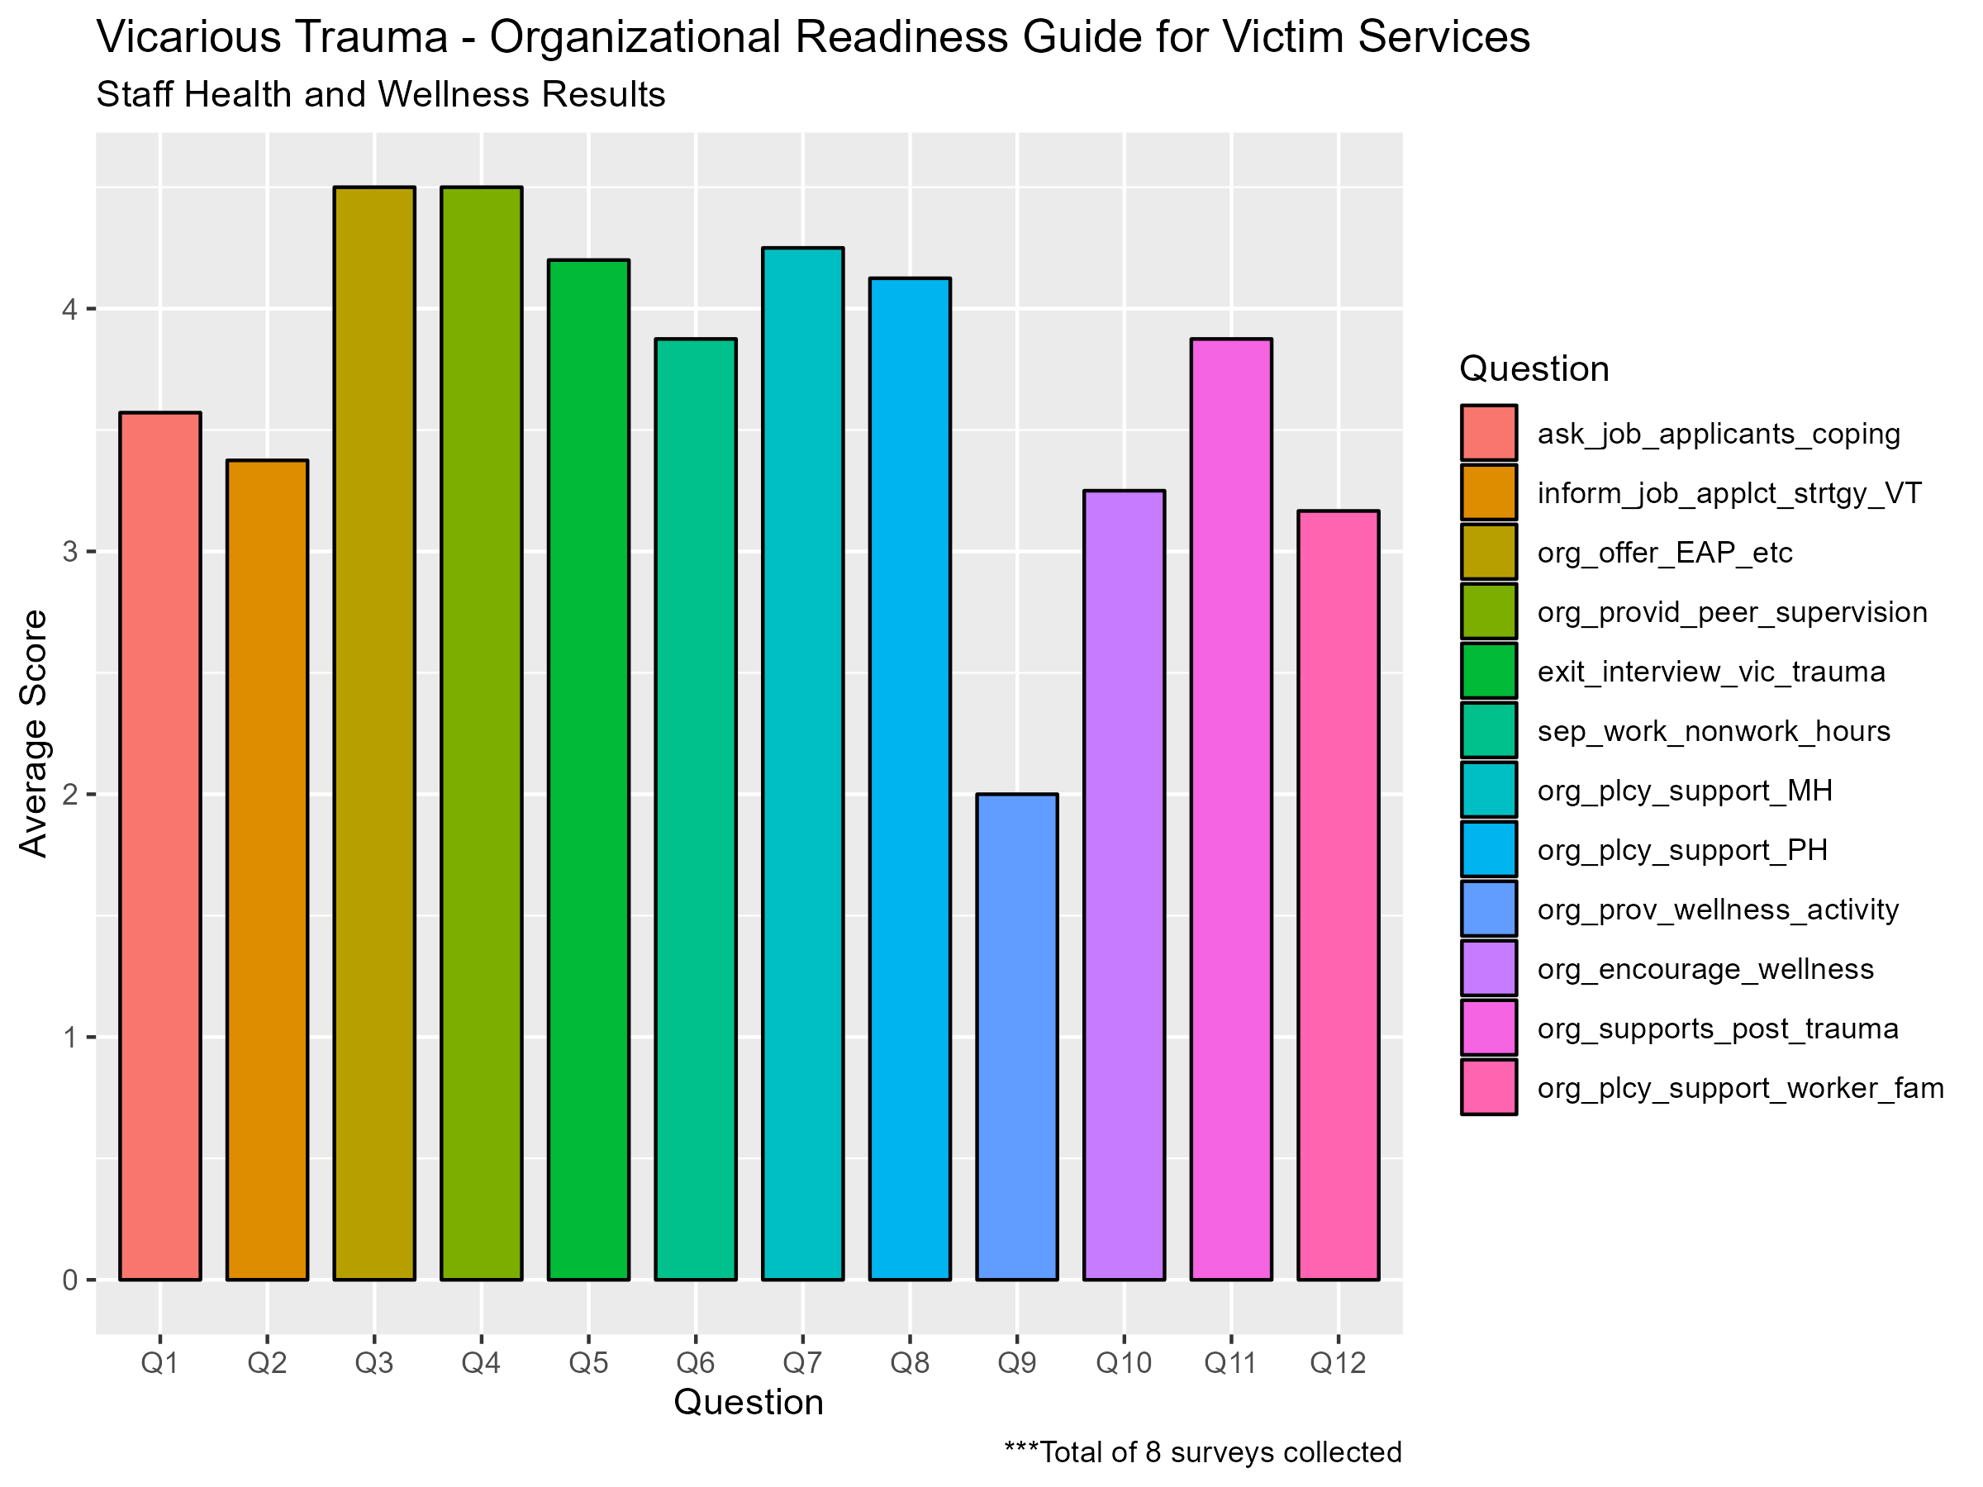
Attention needed on questions 1-2, 9-10, and 11.

Slide 21
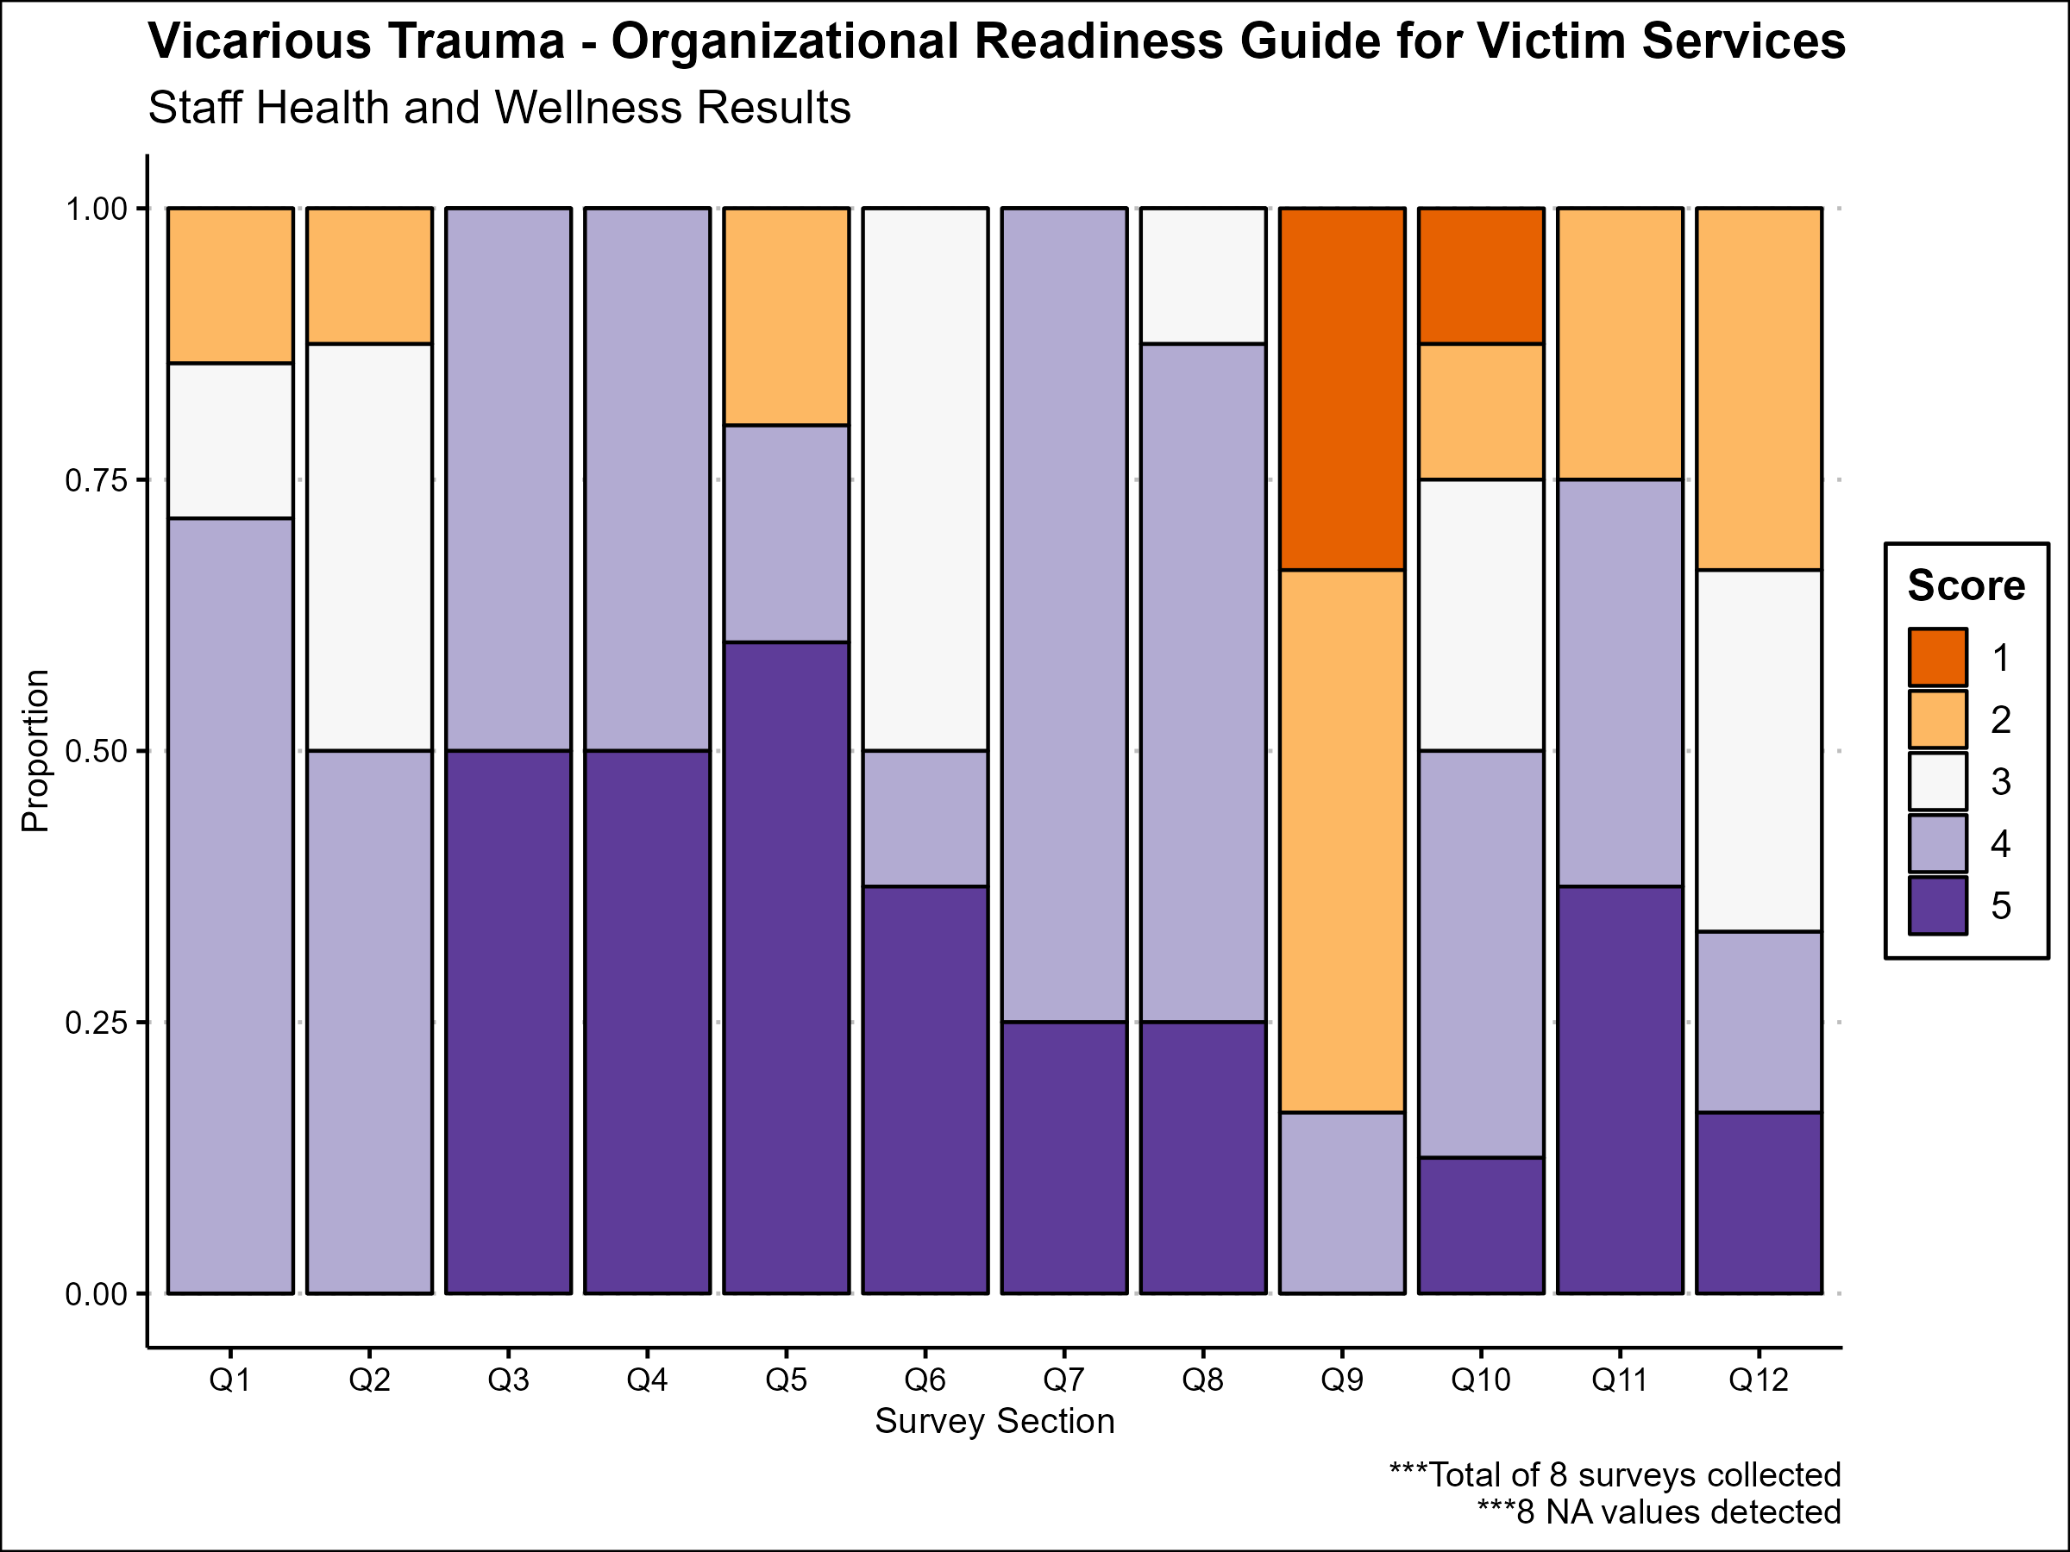
Question 6 should be discussed as well based on the analysis of proportions

